Slide 1
Software Construction
mutability and immutability

Slide 2
Introduction
Mutable and immutable are English words that mean "can change" and "cannot change" respectively. The meaning of these words is the same in C# programming language; that means the mutable types are those whose data members can be changed after the instance is created but Immutable types are those whose data members can not be changed after the instance is created.

Slide 3
Memory impact
When we change the value of mutable objects, value is changed in same memory.
But
In immutable type, the new memory is created, and the modified value is stored in new memory.
a
af
a | a | a
ac | ad | af

Slide 4
Mutable Variables
Mutable data types are those whose values can be modified after they are created without creating a new instance.
They have methods that change the value of the object.
Operations on mutable data types directly modify the data in memory.
Examples of mutable data types include lists and dictionaries in Python.
Mutable data types are used when you need to modify data frequently or when you want to maintain a single instance with changing values.

Slide 5

Cont..
StringBuilder is an example of a mutable type. It has methods to delete parts of the string, insert or replace characters, etc.
StringBuilder sb = new StringBuilder("a");
sb.Append("b");
StringBuilder has other methods as well, for deleting parts of the string, inserting in the middle, or changing individual characters.

Slide 6
Immutable Variables
Immutable data types are those whose values cannot be changed or modified after they are created.
Once created, they always represent the same value.
Any operation that appears to modify an immutable data type actually creates a new instance with the desired changes.
Examples of immutable data types include strings, tuples, and frozensets in Python.
Immutable data types are useful for situations where you want to ensure that the data remains constant, avoiding unintended changes.

Slide 7
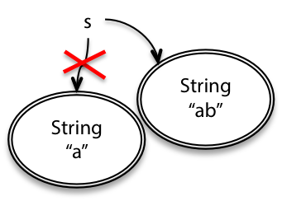
Cont…
String is an example of an immutable type. A String object always represents the same string.
Since String is immutable, once created, a String object always has the same value. To add something to the end of a String, you have to create a new String object:
String s = "a";
s = s + ("b");

Slide 8
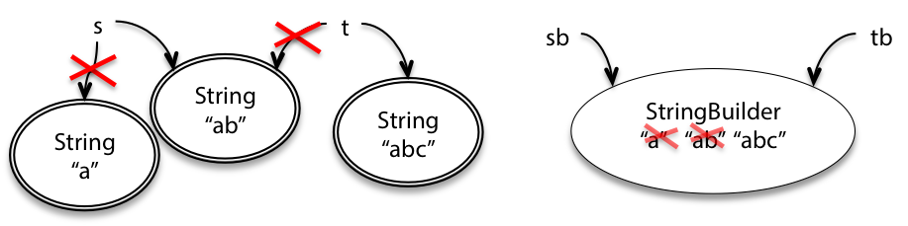
So what?
In both cases, you end up with s and sb referring to the string of characters "ab".
The difference between mutability and immutability doesn’t matter much when there’s only one reference to the object.
But there are big differences in how they behave when there are other references to the object.
For example, when another variable t points to the same String object as s, and another variable tb points to the same StringBuilder as sb, then the differences between the immutable and mutable objects become more evident:
String t = s;
t = t + "c";
StringBuilder tb = sb;
tb.Append("c");

Slide 9
Cont.
Since we have the immutable String class already, why do we even need the mutable StringBuilder in programming? A common use for it is to concatenate a large number of strings together. Consider this code:
String s = "";
for (int i = 0; i < n; ++i) {
s = s + n;
}

Slide 10
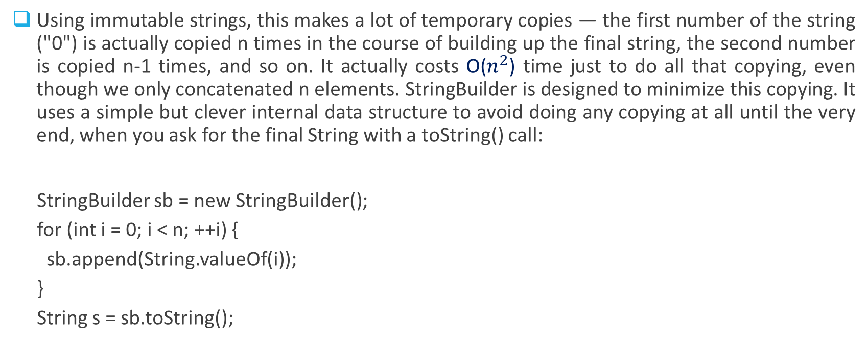
Cont.
Using immutable strings, this makes a lot of temporary copies — the first number of the string ("0") is actually copied n times in the course of building up the final string, the second number is copied n-1 times, and so on. It actually costs O($n^{2}$) time just to do all that copying, even though we only concatenated n elements. StringBuilder is designed to minimize this copying. It uses a simple but clever internal data structure to avoid doing any copying at all until the very end, when you ask for the final String with a toString() call:
StringBuilder sb = new StringBuilder();
for (int i = 0; i < n; ++i) {
sb.append(String.valueOf(i));
}
String s = sb.toString();

Slide 11
Cont.
Getting good performance is one reason why we use mutable objects.
Another is convenient sharing: two parts of your program can communicate more conveniently by sharing a common mutable data structure.

Slide 12
Example (Python)
# Immutable Data Type (String)
immutable_str = "Hello"
new_str = immutable_str.upper() # Creates a new instance
print(immutable_str) # Output: "Hello"
print(new_str) # Output: "HELLO"
# Mutable Data Type (List)
mutable_list = [1, 2, 3]
mutable_list.append(4) # Modifies the existing list
print(mutable_list) # Output: [1, 2, 3, 4]

Slide 13
Risks of mutation
Mutable types seem much more powerful than immutable types. If you were shopping in the Datatype Supermarket, and you had to choose between a boring immutable String and a super-powerful-do-anything mutable StringBuilder, why on earth would you choose the immutable one? StringBuilder should be able to do everything that String can do, plus set() and append() and everything else.
The answer is that immutable types are safer from bugs, easier to understand, and more ready for change. Mutability makes it harder to understand what your program is doing, and much harder to enforce contracts. Here are two examples that illustrate why.

Slide 14
Risky example #1: passing mutable values
Let’s start with a simple method that sums the integers in a list:
public static int sum(List<int> list)
{
int sum = 0;
foreach (int x in list)
sum += x;
return sum;
}

Slide 15
Cont.
Suppose we also need a method that sums the absolute values. Following good DRY practice (Don’t Repeat Yourself), the implementer writes a method that uses sum():
public static int sumAbsolute(List<int> list)
{
// let's reuse sum(), because DRY, so first we take absolute values
for (int i = 0; i < list.Count; ++i)
list.Insert(i, Math.Abs(list.IndexOf(i)));
return sum(list);
}
Notice that this method does its job by mutating the list directly. It seemed sensible to the implementer, because it’s more efficient to reuse the existing list. If the list is millions of items long, then you’re saving the time and memory of generating a new million-item list of absolute values. So, the implementer has two very good reasons for this design: DRY, and performance.

Slide 16
Cont.
But the resulting behavior will be very surprising to anybody who uses it! For example:
int[] array = { -5, -3, -2 };
List<int> myData = new List<int>(array);
Console.WriteLine(sumAbsolute(myData));
Console.WriteLine(sum(myData));
What will this code print? Will it be 10 followed by -10? Or something else?
Let’s think about the key points here:
Safe from bugs? In this example, it’s easy to blame the implementer of sum­Absolute() for going beyond what its spec allowed. But really, passing mutable objects around is a latent bug. It’s just waiting for some programmer to inadvertently mutate that list, often with very good intentions like reuse or performance, but resulting in a bug that may be very hard to track down.
Easy to understand? When reading main(), what would you assume about sum() and sum­Absolute()? Is it clearly visible to the reader that myData gets changed by one of them?

Slide 17
Risky example #2: returning mutable values
What about returning a mutable object?
Let’s consider Date , one of the built-in Java classes. Date happens to be a mutable type. Suppose we write a method that determines the first day of spring:
/** @return the first day of spring this year */
public static Date startOfSpring() {
return askGroundhog();
}

Slide 18
Cont.
Clients start using this method, for example to plan their big parties:
// somewhere else in the code...
public static void partyPlanning() {
Date partyDate = startOfSpring();
// ...
}

Slide 19
Cont.
All the code works and people are happy. Now, independently, two things happen. First, the implementer of startOfSpring() realizes that the groundhog is starting to get annoyed from being constantly asked when spring will start. So the code is rewritten to ask the groundhog at most once, and then cache the groundhog’s answer for future calls:
/** @return the first day of spring this year */
public static Date startOfSpring() {
if (groundhogAnswer == null) groundhogAnswer = askGroundhog();
return groundhogAnswer;
}
private static Date groundhogAnswer = null;

Slide 20
Second, one of the clients of startOfSpring() decides that the actual first day of spring is too cold for the party, so the party will be exactly a month later instead:
// somewhere else in the code...
public static void partyPlanning() {
// let's have a party one month after spring starts!
Date partyDate = startOfSpring();
partyDate.setMonth(partyDate.getMonth() + 1);
// ... uh-oh. what just happened?
}

Slide 21
Cont.
In both of these examples
— the List<Integer> and the Date
— the problems would have been completely avoided if the list and the date had been immutable types. The bugs would have been impossible by design.
In fact, you should never use Date ! Use one of the classes from package java.time : LocalDateTime , Instant , etc. All guarantee in their specifications that they are immutable .
return new Date(groundhogAnswer.getTime());

Slide 22
Scenario 1: Bank Transactions (Immutability)
In a banking system, when a customer makes a financial transaction, it's important to maintain a history of these transactions. Immutability is crucial in this scenario to ensure the integrity of the transaction records. Here's how it works:
Immutability: When a transaction occurs, a new transaction record is created and added to the customer's transaction history. The previous history remains unchanged. This ensures that the historical record of transactions is preserved, and any audit or investigation can rely on the integrity of the data.

Slide 23
Scenario 2: Social Media Posts (Mutability)
n a social media platform, users can post, edit, or delete their content. Mutability is important in this scenario to allow users to update their posts. Here's how it works:
Mutability: Users can create a post, edit the content, and delete it if they choose. This flexibility allows users to correct typos, update information, or remove posts that are no longer relevant. The system updates the existing post rather than creating a new one each time the user edits.

Slide 24
Scenario 3: Medical Records (Immutability)
In the healthcare industry, patient medical records must be kept secure and immutable to maintain a complete and accurate history of patient health. Here's how it works:
Immutability: When a patient undergoes a medical procedure or consultation, a new entry is added to their medical record. Once recorded, these entries should not be altered. Immutability ensures that the patient's medical history remains intact, enabling doctors to make informed decisions based on the unchangeable historical data.

Slide 25
Scenario 4: Inventory Management (Mutability)
In a retail environment, inventory levels constantly change due to sales, restocking, and returns. Mutability is important to reflect these real-time changes. Here's how it works:
Mutability: When items are sold or restocked, the inventory management system updates the quantity on hand, deducting items sold and adding items restocked. This real-time mutability allows the system to maintain accurate inventory levels, helping businesses manage stock efficiently.

